Slide 1

OKRs, Hypotheses, and Testing
Presented by: NoSlacking!
Theja Ajit, Divyansh Chouhan, Isabella Eriksen, Brinda Sarkar, Mohit Shah

Slide 2



OKRs
Objective: Have an easier user interface that is easy to understand by customers
Key Results:
Increase customer satisfaction by 35%
Increase in number of sessions per user per day
Decrease in average session duration
Increase in number of sign-ups/decrease in churn rate by 25%
Objective: Have more compliance for university settings
Key Results:
Become FERPA compliant
Increase student users by 20%
Add 50 new universities/year
Objective : Enable users to use video/voice call features better
Key Results:
Increase in clicks for video/voice call features by 15%
Increase of activity duration of customers by 20%
Increase in number of messages sent per users by 15%

Slide 3

Idea Comparison
Market success probability
High
Med
Low
 | Slack Scheduler | Slack Voice | Slack University | Slack Summarize | Slack Student
What does it do? | Improved support for meetings, video calls. | Automated dictation and text-to-speech tool | Integrated university coursework support | Auto-generated summary of unread chats, tags. | 100% FERPA compliance
Business Impact | Helps employees and students | Makes Slack more accessible | Increases tie up with Universities | More engagement, acts as USP | Increases tie up with Universities
Customer Satisfaction | One stop shop for communication | Increase satisfaction of select groups | More students start using it for courses | Increase satisfaction for select number of users | More students start using it
Innovative Technology | UI and integrations | Uses NLP | UI and integrations | ML and AI | NA
University Outreach | Ease of remote class/group work | Better experience for students & prof | Highly tailored for coursework | Fast turnaround for students & prof. | More universities onboard Slack
Direct competitors | Teams | None | None | In pipeline | Teams
“Slack University” is viewed to have highest probable as a success based on internal factors impacting business, customer, technology and feasibility.
By re-designing the user-experience, university courses can smoothly transition between Slack and Canvas, with the integration into our product.
Direct doubt solving channels with professors, TA’s and classmates
FERPA compliance to enable document sharing
Accessible coursework and assignment submission via slack channels

Slide 4


MVP for Slack University
Hypothesis-
Slack University will begin with a limited scope, with continuous support beginning in June 2023, and plans to expand to the west coast region by June 2024.
Specifications for this MVP-
Geographic scope: Pacific NorthWest area
Seat size: >2,000 students and faculty
School type: Private
Currently, we have agreements with Gonzaga University, Whitman College, and Whitworth University
We are hoping to expand to the following Universities within the Pacific Northwest Region: Montana State University, University of Washington, Oregon State University
Requirements -
Universities have dedicated annual budgets for collaboration with learning management systems like Canvas
Students have experience using online communication platforms
Students have, or have the resources to acquire, a personal electronic device (such as a laptop or tablet)
Core Assumptions -
Students and Professors
Increased user activity
Optimized course productivity
Single platform to meet all educational requirements
University
Increased graduation rates
Seamless integration of Course Workspaces
Reduced requests for product support, IT support
Lower overall license costs

Slide 5



Type of MVPs
Target Practice
Smoke and Mirrors
Piece of Pie
Setting up individual university tie-ups
APIs to integrate with existing LMS like Canvas
Regional universities in the whole of USA
Invest
Invest
Invest
Expansion of customer base
Building a fully in-house feature
Slack updates for other target customers
Deprioritize
Deprioritize
Deprioritize
Customer satisfaction
Customer satisfaction
Customer acquisition
Test for
Test for
Test for
Opting for Target Practice will be the ideal MVP strategy for Slack University

Slide 6
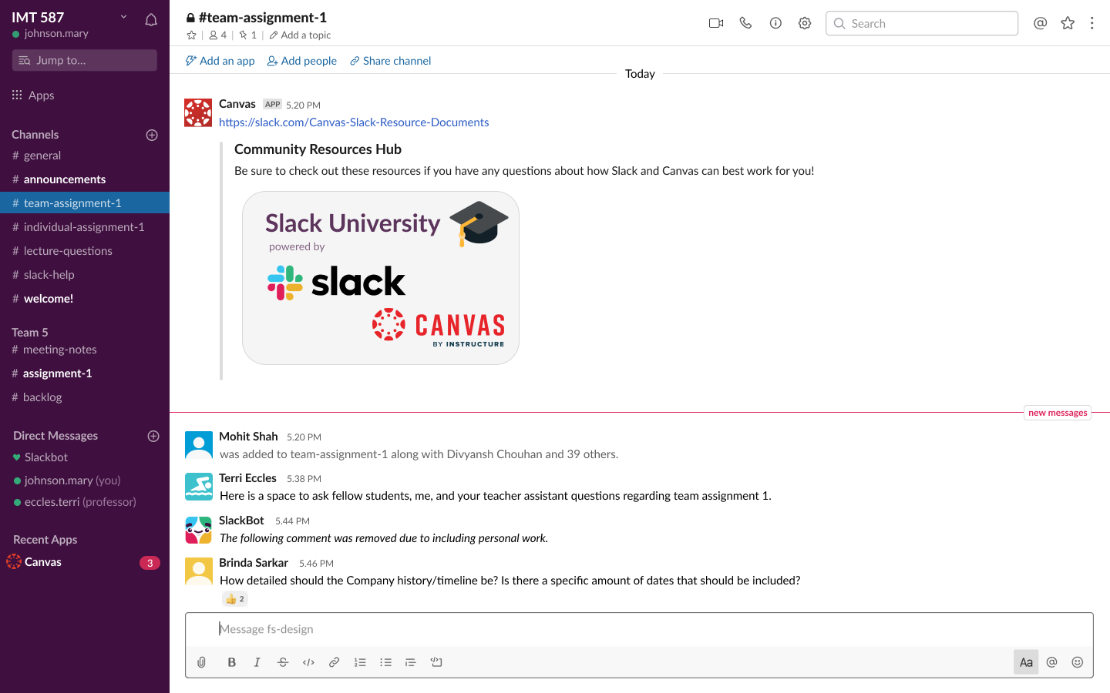
Our MVP
Target Practice
Basic wireframe for the feature
Based on our envisioned hypothesis for the MVP, Slack University will target a handful of universities, with the aim of achieving high customer satisfaction. After developing proven success case studies for Slack University, we expect the feature to be rolled out to other universities soon. As of today, Slack University meets all the requirements for the target group of universities we have collaborated with.
Slack University Draft Wireframe

